Slide 1
PRATICAL DATA SCIENCE Assignment 3
By: Tenzing Sangay Bhutia (s3680446) and Qianwei Yang (S3716296)

Slide 2
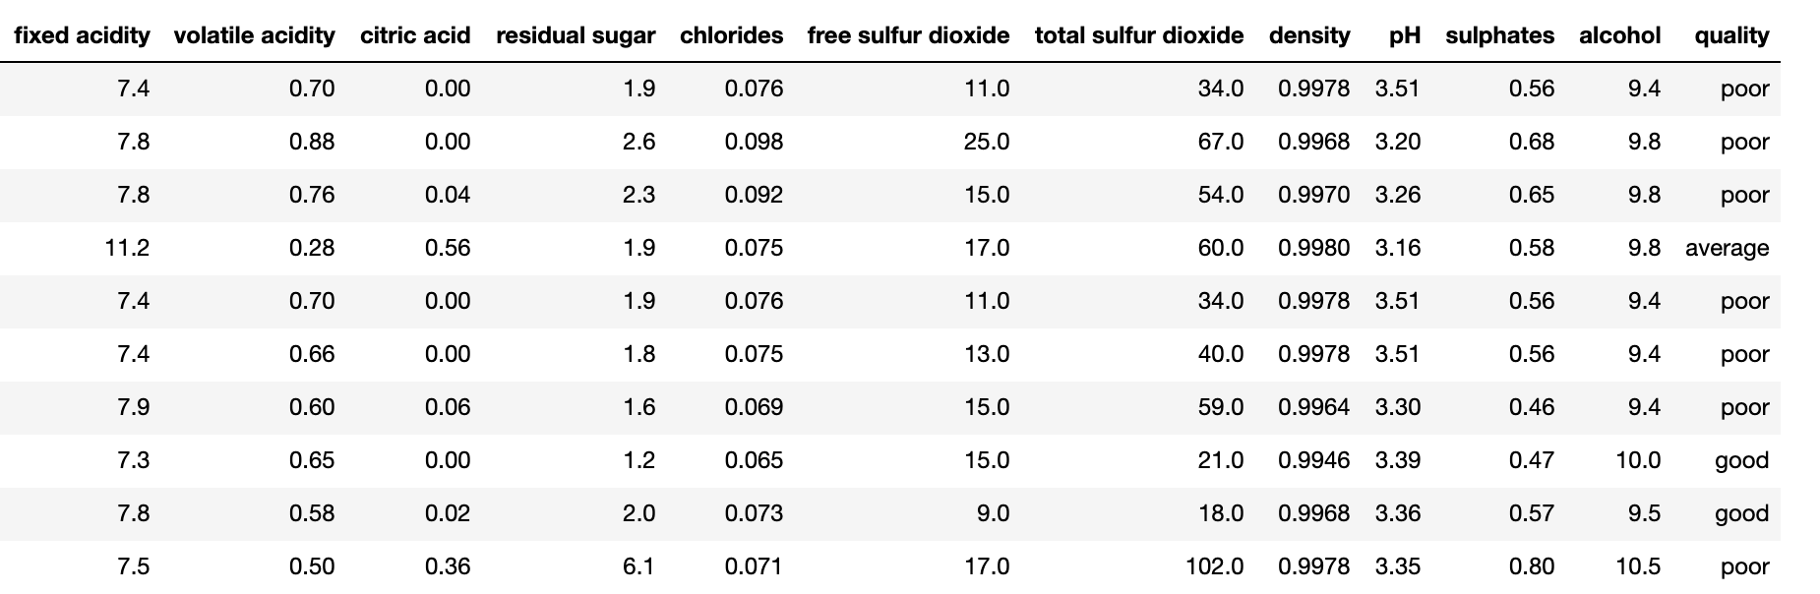
OBJECTIVE :
The objective of this project is to predict the quality of red wine and investigate the following hypothesis:
The quality of low alcoholic red wine is better than that of high alcoholic red wine.
How does acidity and density effect the quality of red wine.
METHODOLOGY:
DATA RETRIEVING : The dataset was loaded into the workspace and was made sure that it was equivalent to the source file.
DATA PREPROCESSING: Elaborate Check in the content . The presence of duplicate values was recognized hence it was removed to prevent bias in the result.
Data Exploration: In this stage we explore explore each column and see their relationship.
.

Slide 3
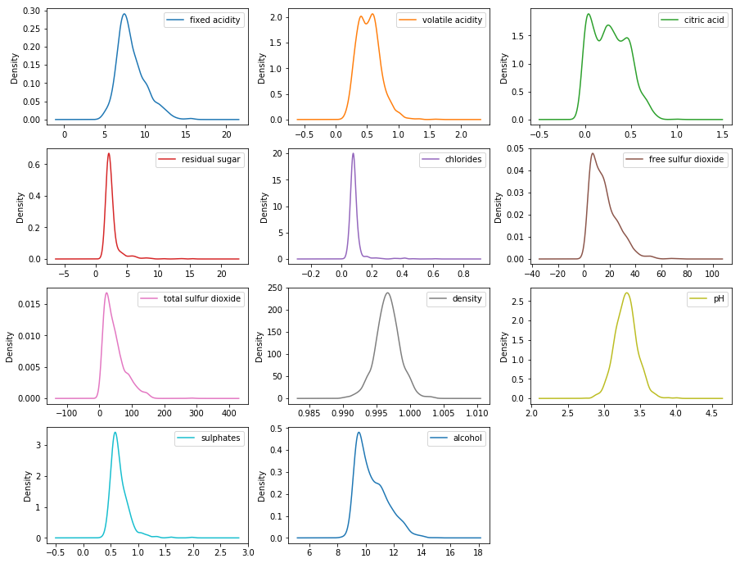
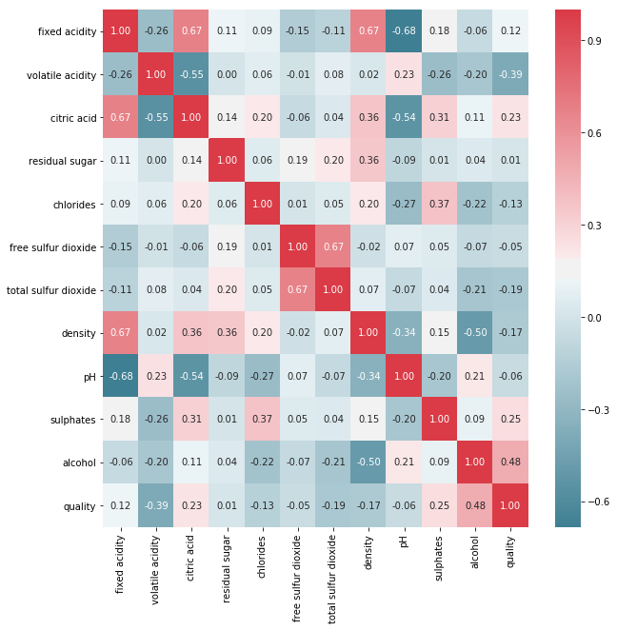
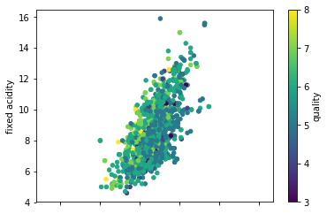
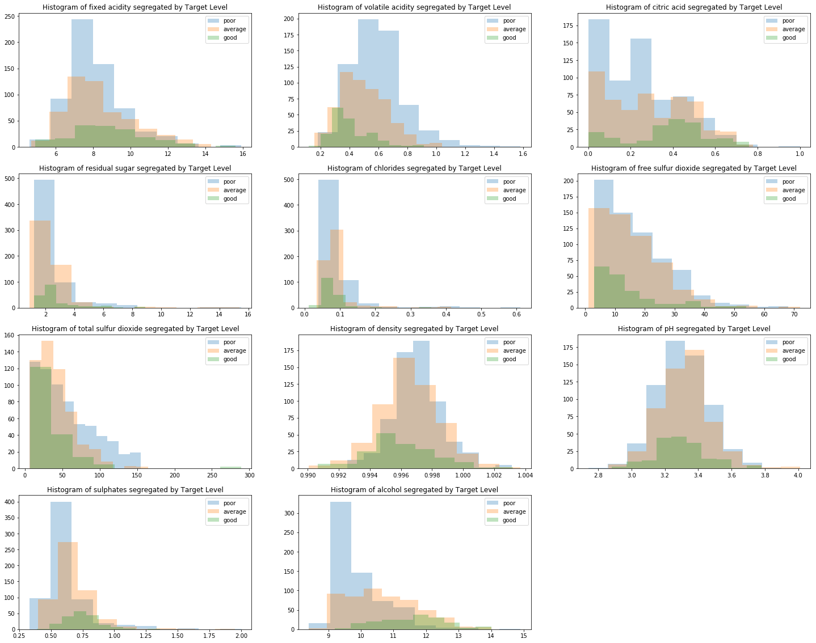
Checking the Hypothesis and Research Question:
Results:
Wines with high alcoholic content are normally of better quality.
Density and acidity are positive correlated however there is no significant effect on the quality.

Slide 4
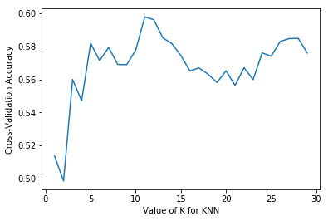
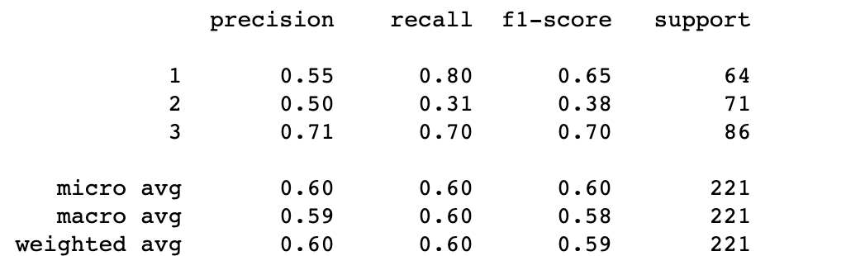
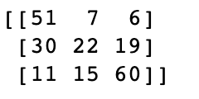
DATA MODELING:
Modeling Techniques : KNN AND DECISION TREE
K-Nearest Neighbours:
Feature Engineering: Kept the variable with strong positive correlation and strong negative correlation.
Parameter Tuning : Used the Hyperparameter tuning method to determine the K value and the parameters.
Best K: 11
Best Model Accuracy : 60.28 %.
Decision Tree:
Parameter Tuning : Iteration of Method.
Best Accuracy: 50.45%

